Slide 1
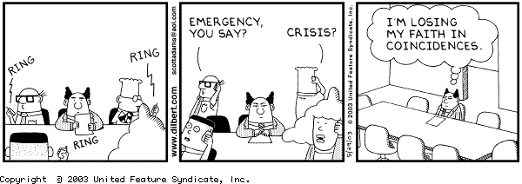
Improving Meeting Effectiveness

Slide 2
Agenda
Principles of an effective meeting
Questions to improve meetings you’re in
5 tips to lead an effective meeting
4 tips to a more synergistic meeting
Software tools to get the most of your meeting

Slide 3

Maintaining the Balance
GOAL / PURPOSE
PRODUCTION
CAPACITY
Start & Stop on time
Clear Expectations
Achieve Results !
Generate:
Focus
Enthusiasm
Improved Communication
Synergy

Slide 4
Principles of an Effective Meeting
An effective meeting maintains a balance between reaching its goal and maintaining the production capacity of the attendees
Those involved in the meeting have a clear understanding of why they are attending
The responsibilities, and task items resulting from the meeting are clearly understood and accepted by each individual
The meeting starts and stops on time.

Slide 5
Questions to Consider
What is the goal of this meeting ?
What role do I play in adding to this meeting ?
Is my role in this meeting necessary to its success, is there another way ?
How does this meeting fit into my schedule ?

Slide 6
Tips to Effective Meetings
Have a clear objective
Don’t have the meeting
Have an agenda
Start & Stop on time
Share the meeting minutes

Slide 7
Understanding Synergy
Synergy is the concept of the whole being more than the sum of its parts
Each person brings his/her own ideas and concepts to the table, and ideas for change & improvement
Synergy finds the 3rd alternative
“Feeling” that needs are met even though plan is different

Slide 8
Tips to Improve Synergy
Nobody Speaks:
As the organizer, have your own idea/suggestions to start the communication process.
Encourage others to challenge, the strength's weakness of this approach

Slide 9
Tips to Improve Synergy
Everyone Speaks (at once)‏
As organizer, jot each idea down on a piece of paper, avoid going into details of each idea, until each idea has been voiced.
Then working down the list, identify the key ingredients of each idea (good points, pitfalls)‏
Identify as a team what sounds like the “best” solution
Modify the “best” solution by using other ideas to reduce the pitfalls / weak points

Slide 10
Tips to Improve Synergy
Strong Disagreement:
Jot down the main point of the disagreement.
Ask the question: how can the “best’ solution can be modified to meet this problem
Avoid trying to prove that your idea is the WINNER, seek the 3rd solution !

Slide 11
Tips to Improve Synergy
Personal Involvement:
One member may have a strong response to an idea, often feels he/she needs to prove he/she knows the answer.
This is natural and expected.
Encourage others to express their own thoughts
Seek first to understand, then to be understood

Slide 12
Software Tips
Agenda’s can be easily prepared by using the letter template in Word.
Our meeting minutes template will help to stay focused as you move through each agenda item ; and assign owners to activities as discussed
Outlook Meeting Requests allow for easy view of free/busy information provided your calendar is as up-to-date as possible.

